Slide 1

Git Hub Archive Data Analysis
Analyzed the type of events that happened on 17th July 2020
Analyzed the number of issues that were created
Analyzed the average number of issues that were opened or closed on this day.
Minakshi Kesarwani

Slide 2
Workflow:
Extracted data from GHarchive
Processed the Data
Transformed Data
Performed Analysis
Exported analyzed data to AWS S3 bucket
https://databricks-prod-cloudfront.cloud.databricks.com/public/4027ec902e239c93eaaa8714f173bcfc/2434938452629850/1247632240937483/2362818579145263/latest.html

Slide 3
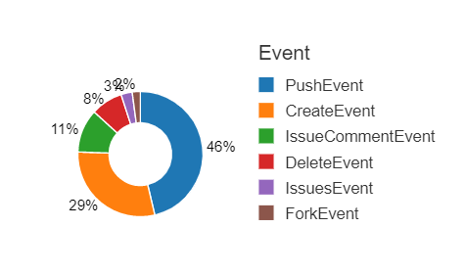
Analyzed the Type of Events executed
On 17th July 2020, i.e. on a Friday, most of the users have pushed their data into the repositories.
Insight:
This day’s activity suggest that 46% of users were engaged in pushing their data into their repositories, followed by 29% of users creating new repositories.

Slide 4
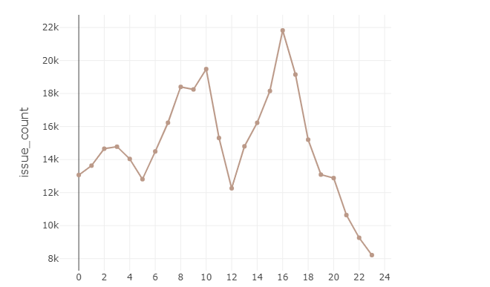
Analyzed the number of issues raised per hour
Insight:
This trend suggests that most people raise their issues during their official working hours
On Friday, most of the issues that were raised in Github were in between 8:00AM - 6:00PM with maximum issues raised at 4:00PM

Slide 5
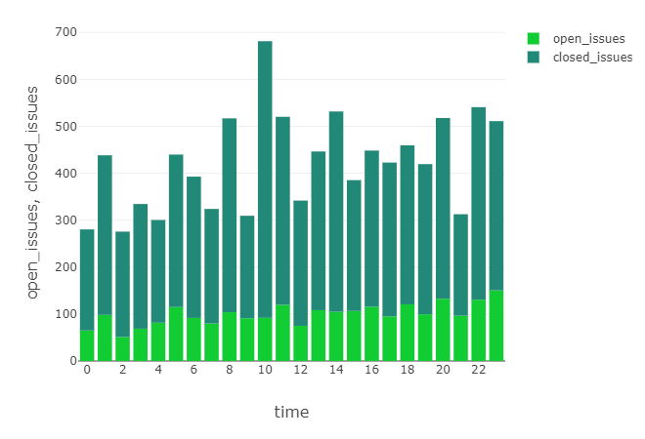
Analyzed the Open/ Closed Issues per hour
At 10:00 AM, 90% of issues that were created by the users were closed.
Insight:
This graph suggests that , on an average, more than 60% of the issues that were raised were resolved within a day’s time.

